Slide 1
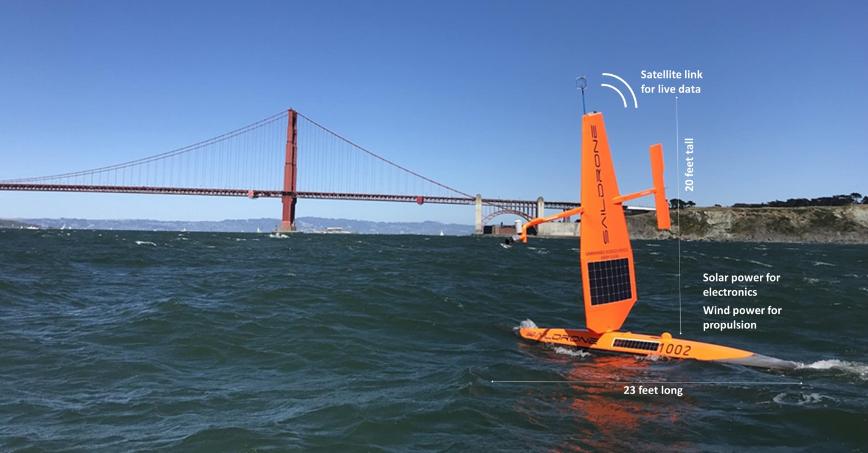
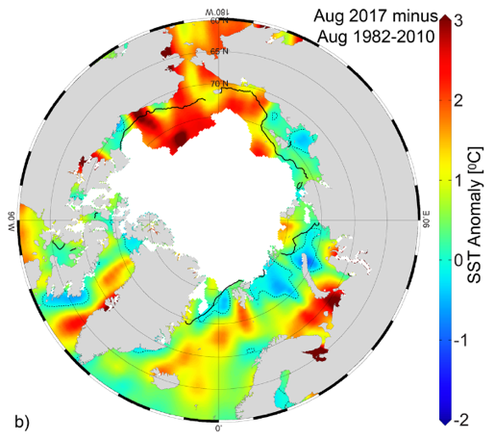




MISST and SSS projects
Validation of satellite data
Sea Surface Temperature (SST)
&
Sea Surface Salinity (SSS)
in challenging environments

Slide 2
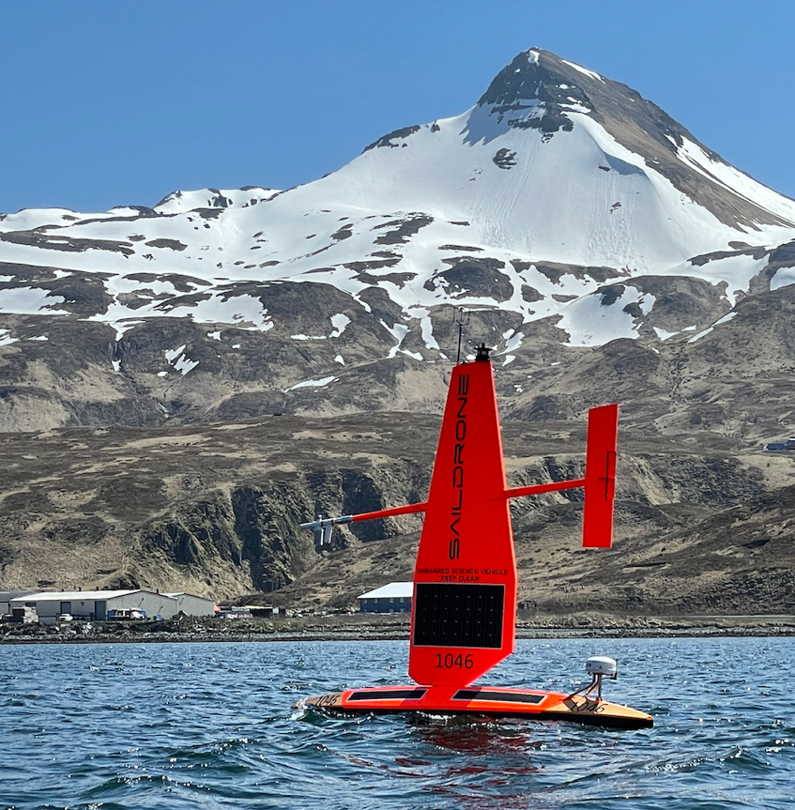
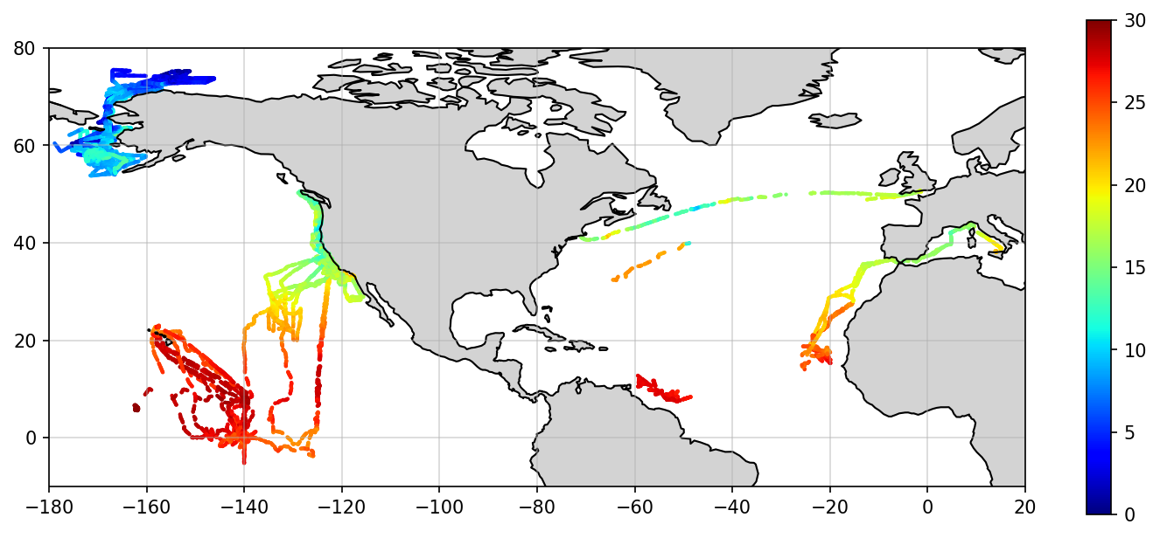
45 Cruises 2015-2021
Temperature @ the Surface (C)

Slide 3
Challenging environments: near ice, near river outputs, coastal areas, fronts
Temperature @ the Surface (C)

Slide 4
Validation
quantification of how close data values are
between satellite and in situ (saildrone) sources
Vazquez-Cuervo et al., 2019

Slide 5
Validation
quantification of how close data values are
between satellite and in situ (saildrone) sources
Comparisons mostly done!
Now the question is “why?”
And get to ask some interesting questions to the data collected
Vazquez-Cuervo et al., 2019

Slide 6
Cleaning the data – only JPL co-located data Functions
When & Where we have data (paul)
Input: a list of files.
Read files (all or a list of them) and plot:
All trajectories (choose a variable, including time, as a color)
A plot with year in the x-axis, and cruise number on the y-axis. (which years there is data). Use color to illustrate month or day of year
A plot with day of year on the x-axis and cruise # on the y-axis. (how much data through the year). use color to illustrate latitude
Output: display and save the 3 plots
Select a region (aleydis)
Input: nothing
Provide a menu of regions and prompt.
Select files of region (California current separate from the rest of the pacific) Output: plot trajectories, return a list of files
Clean anomalies (Austin)
Input: a dataset
Remove all Salinity values = 9999
Identify anomalies (points out of the normal), identify time
If TS plot show only few anomalous points set to nan (check thresholds and adjust)
Can verify w satellite image (both salinity and SST)
Output: return clean dataset
Aggregate data by region (meg)
Input: lat lon range
select all files and data for that range
Merge into one dataset, adding one variable that identify saildrone ID
Return merged dataset
Westcoast (will)
Input: latitudinal rage
All data up to 300 km offshore (not only west coast cruises)
Data inside San Francisco bay set to nan
Only latitudinal range
Return merged dataset

Slide 7
P1: Surface water signature in the California Current (will)
Temperature-Salinity (TS) characteristics determine density and type of water
Are there defined zones in the CC according to surface TS?
Using saildrone data, select west coast, clean and aggregate
Plot TS
Use scikit-learn clustering tool to identify clustering

Slide 8
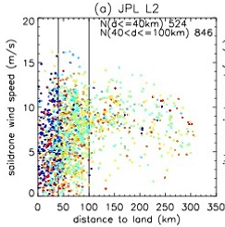
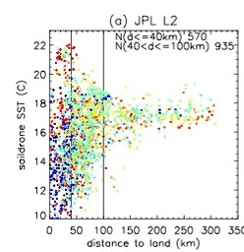
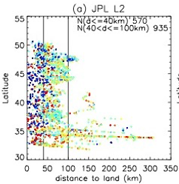

P2: When satellite SSS and SST data has the biggest errors within a region?
(Austin)
Select a region, clean and aggregate data
Calculate differences between saildrone and satellite
Identify minimal, mean and largest differences
Plot and contrast with other variables
Wind, SST or Salinity, distance to land, day of year
When, where, why are differences largest?
Tang et al., in review

Slide 9
P3: Identify upwelling events (part 1) (paul)
In the west coast data:
Identify periods with strong equatorward wind with:
Lower temperatures and high salinities
Plot periods, plus 8 days before and after (time series)
TS plot
Plot trajectories w color as date
Q1: do we have good and enough upwelling events to study?

Slide 10
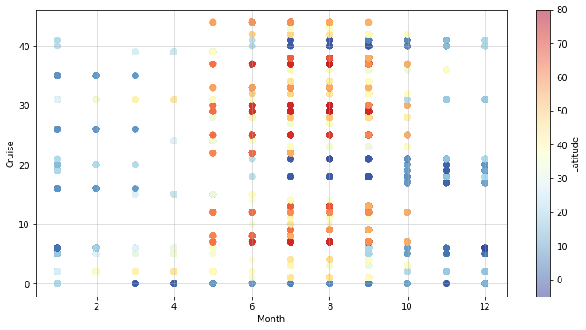
P4:
Do differences between in-situ and satellite values change during the year? (aleydis)
Temperature & Salinity. By Region and/or Global
Aggregate all data for a region in a dataset
Clean data
Compare T or S data from saildrone with co-located satellite data and answer the following questions:
Is there a month with larger/smaller differences?
A region that shows differences through the year?
Are these differences due to Temperature or wind?

Slide 11
P5: Acquire chlorophyll data (meg)
What are chlorophyll-a conditions on a given cruise day?
Open a west coast saildrone cruise
Select 3 dates at random
Get chlo images for those days for a region around the point where saildrone was that day lat/lon +-3 deg
Data from:
https://data.ceda.ac.uk/neodc/esacci/ocean_colour/data/v4.2-release/geographic/netcdf/chlor_a/daily/v4.2
Code example: (4th grey cell (‘# Download each file from our list, and select region’)
https://github.com/marisolgr/python_sat_tutorials/blob/main/Ch8_Land_Example.ipynb

Slide 12
P6: Put together the cleaning the data process
Give a menu and select a region:
Select a set of files
Open files and select data for region
Aggregate into one dataset
Clean anomalies (and if west coast, also take out the bay)
Return
plot data: trajectory and TS plot
New aggregated dataset

Slide 13
P7: All functions together
One file with all the functions
One cell per function
Each function will have all the libraries it needs
Clean up and comment what needs it
In the same script (below) exemplify how to use each function
One of this examples is Project 6.
Test that all work

Slide 14
Question 3 & 4: Can we identify fronts and how large they are
Fronts of salinity due to river run off
Arctic, Northern California Current, Brazil
Fronts of temperature and salinity due to coastal upwelling
California Current, Canary Current

Slide 15
Question 5: What are the surface conditions during upwelling events and how far they extend
Identify upwelling events (strong equatorward alongshore winds, cold temperature, high salinity)
O? Chl?
Compare to satellite data
Other data

Slide 16
Question 7: When do we get higher stratification?
Put together SBE thermistors data with other cruise data
Identify high stratification periods
Compare to other collected data to identify why
Only 1 cruise for now in the Arctic (2019)

